Slide 1
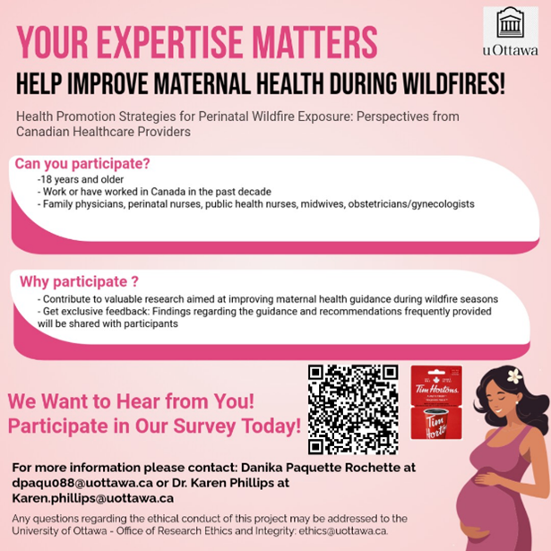

Slide 2
RPNs are invited to share their perspectives, knowledge, and experiences regarding health promotion strategies for perinatal wildfire exposure as part of a research study led by Danika Paquette Rochette (master’s student) and Dr. Karen Phillips at the University of Ottawa. Participants will be asked to complete a survey (approximately 30 minutes).
With no specific Canadian guidelines on wildfire exposure during pregnancy, this initiative supports professional knowledge exchange and helps improve perinatal care amid a growing environmental threat. For more information, please contact Danika at dpaquo88@uottawa.ca or Dr. Karen Phillips at karen.phillips@uottawa.ca.
If you are interested in participating, please follow this link to complete the online survey on promotion strategies for perinatal wildfire exposure:
https://www.surveymonkey.ca/r/C5CR8SC
Any questions regarding the ethical conduct of this project may be addressed to the University of Ottawa – Office of Research Ethics and Integrity at ethics@uottawa.ca.

